Slide 1
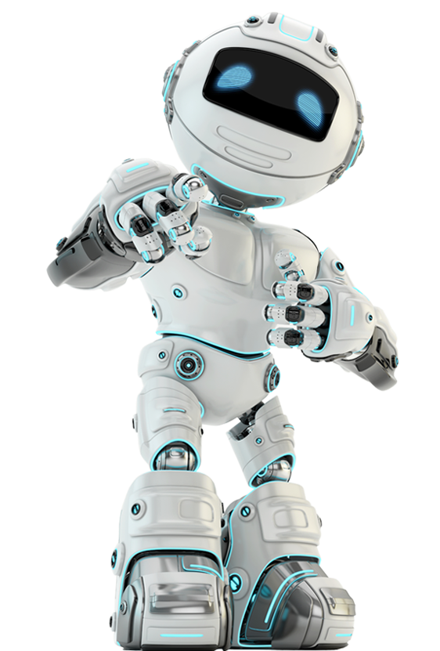
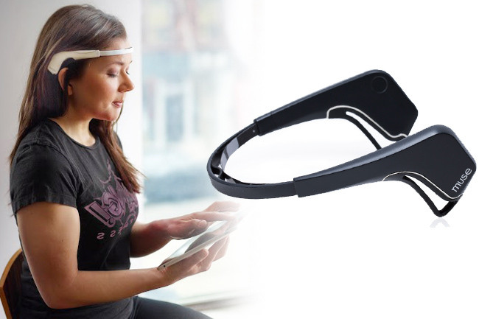
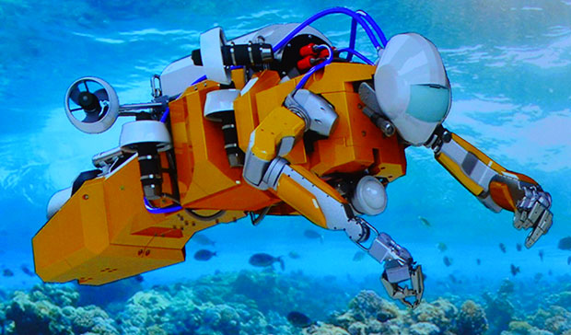
CIS STEAM Camp
WATERKINESIS Day 2

Slide 2
TODAY’S AGENDA
9:30 - 9:45 AM Recap Yesterday, Form Teams & Choose Team Name
9:45 - 10:15 AM Pass Out Robot Kits, Assemble and Connect Robots
10:15 - 10:30 AM Snack Time
10:30 - 11:20 AM Download waterkinesis project for Cognimates Complete worksheets Work on waterkinesis robot design challenge
11:20 - 11:30 AM Screw together and waterproof robots with duct tape
11:30 AM - 12 PM Demo robots at the pool (30 sec per team)

Slide 3
Waterkinesis Day 2
Assembly and Exploration

Slide 4
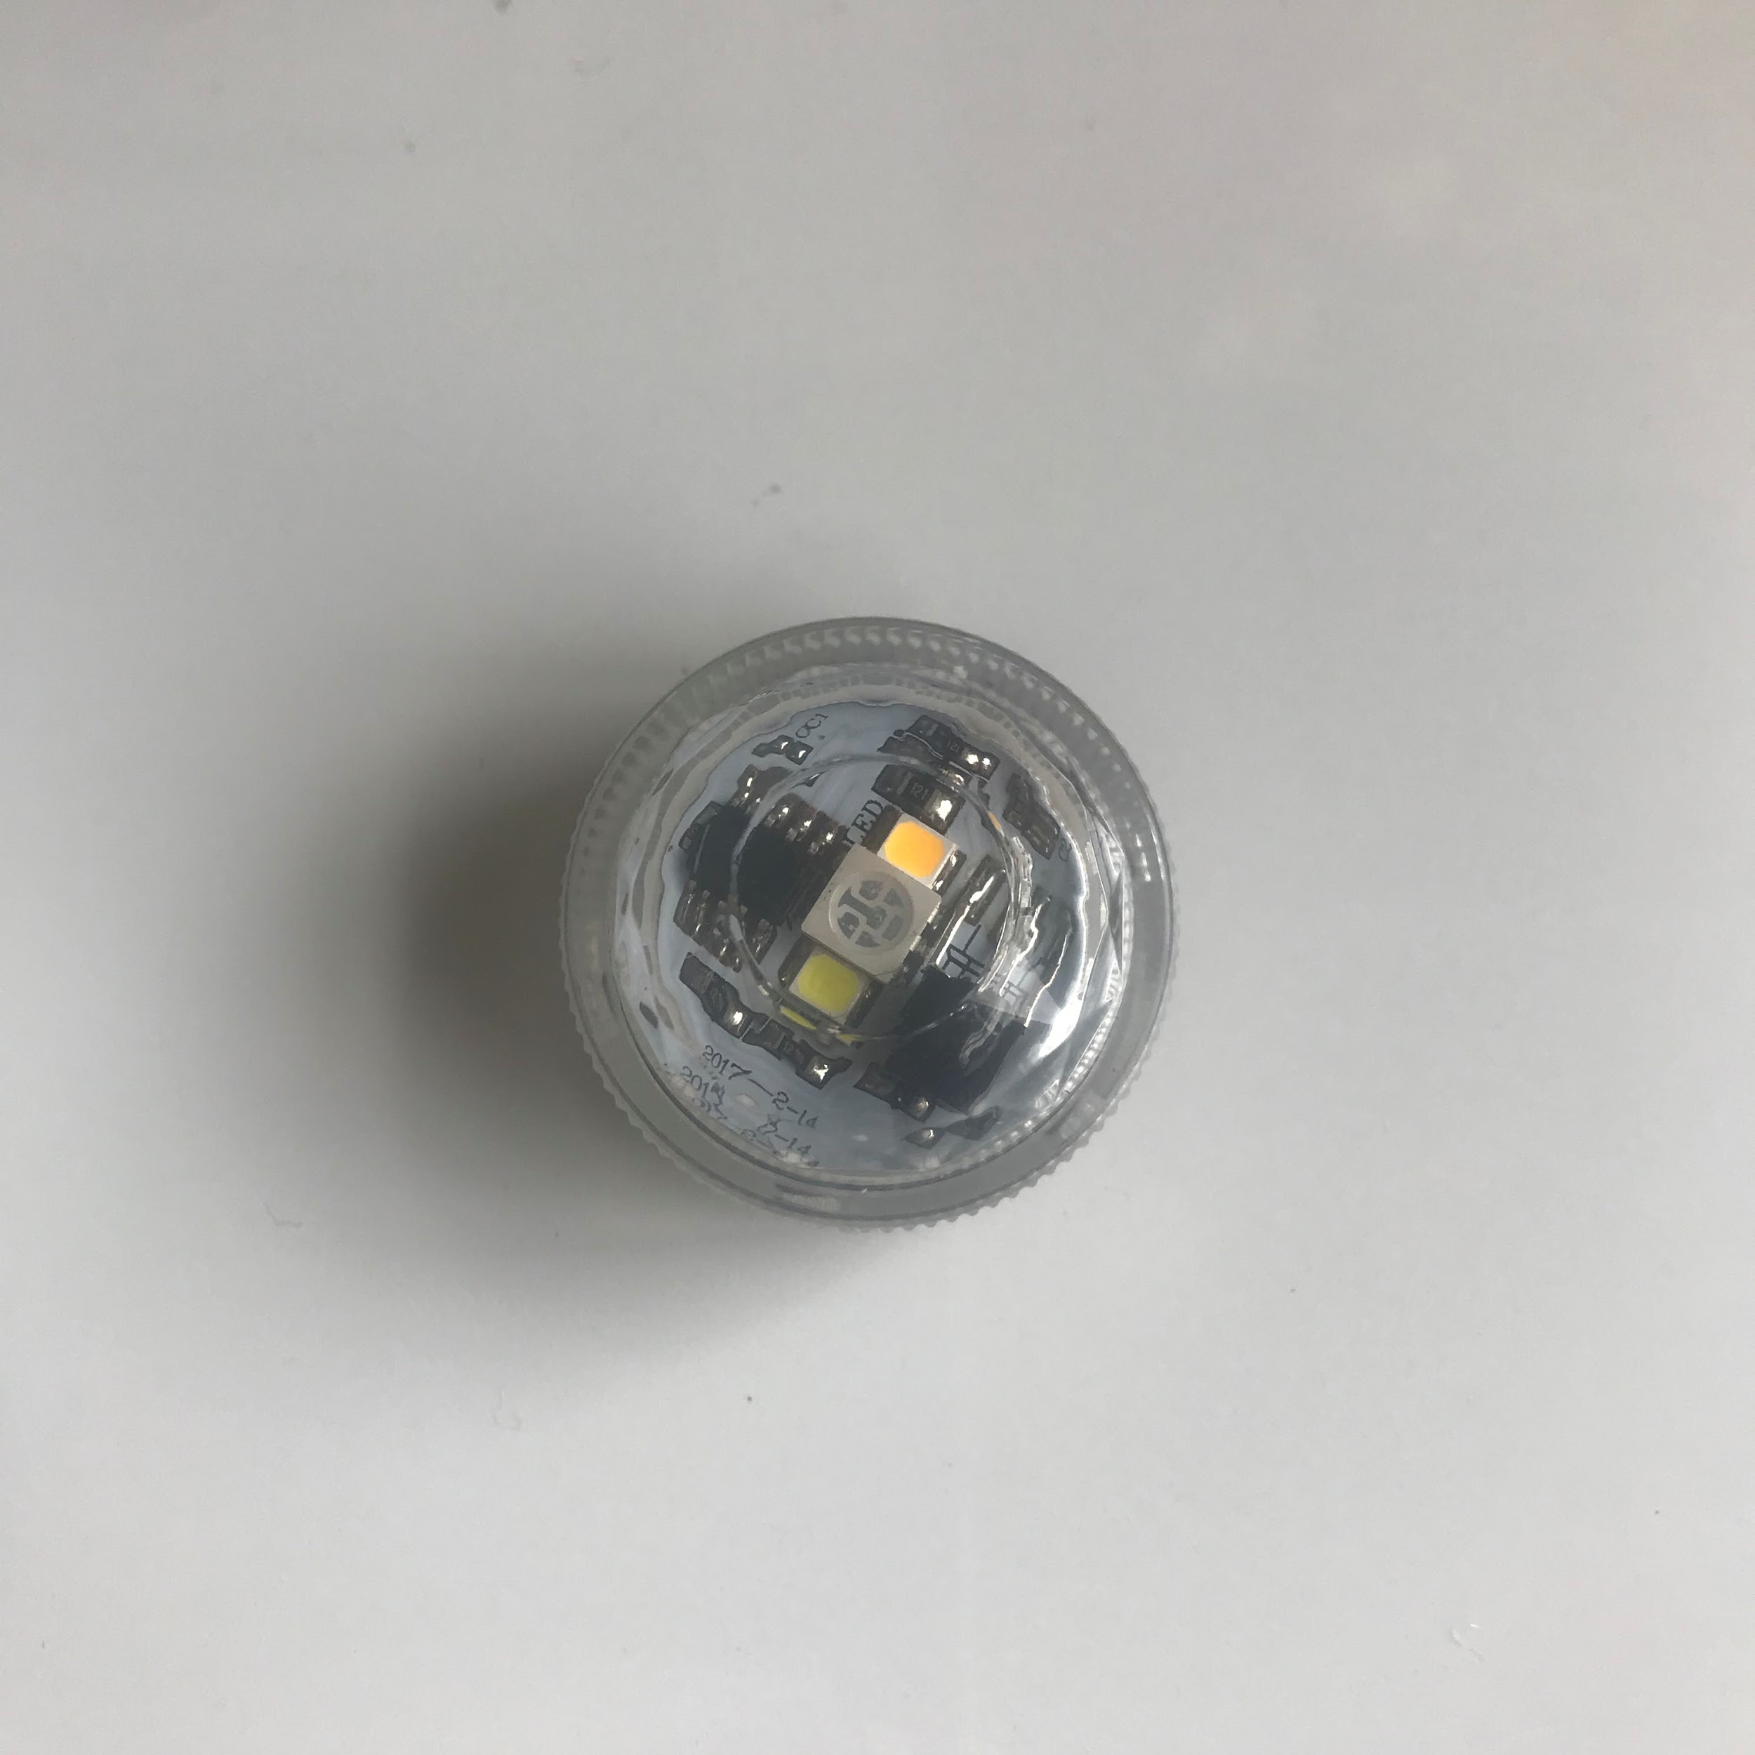
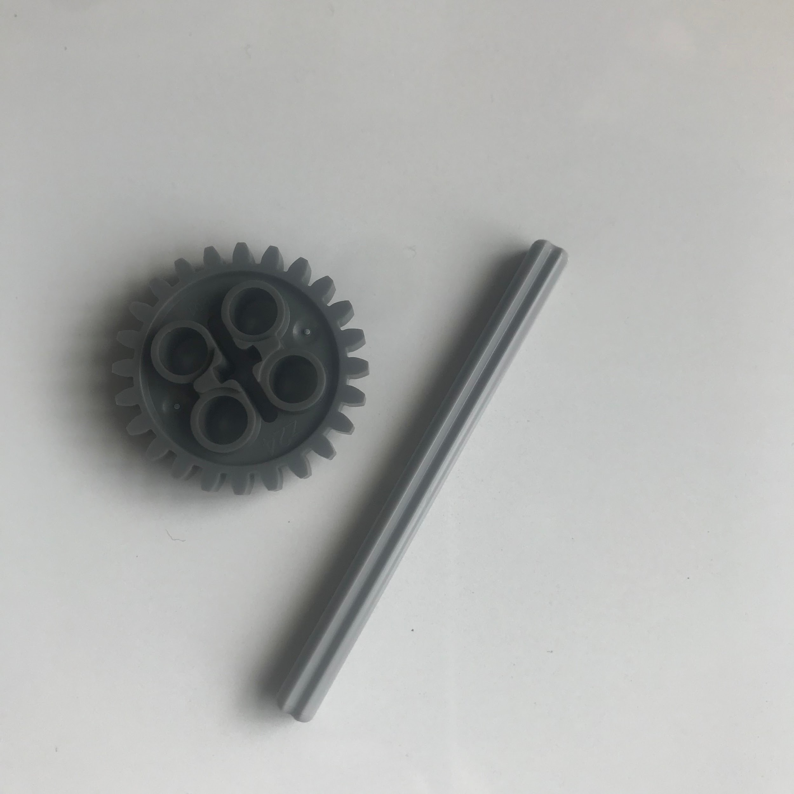
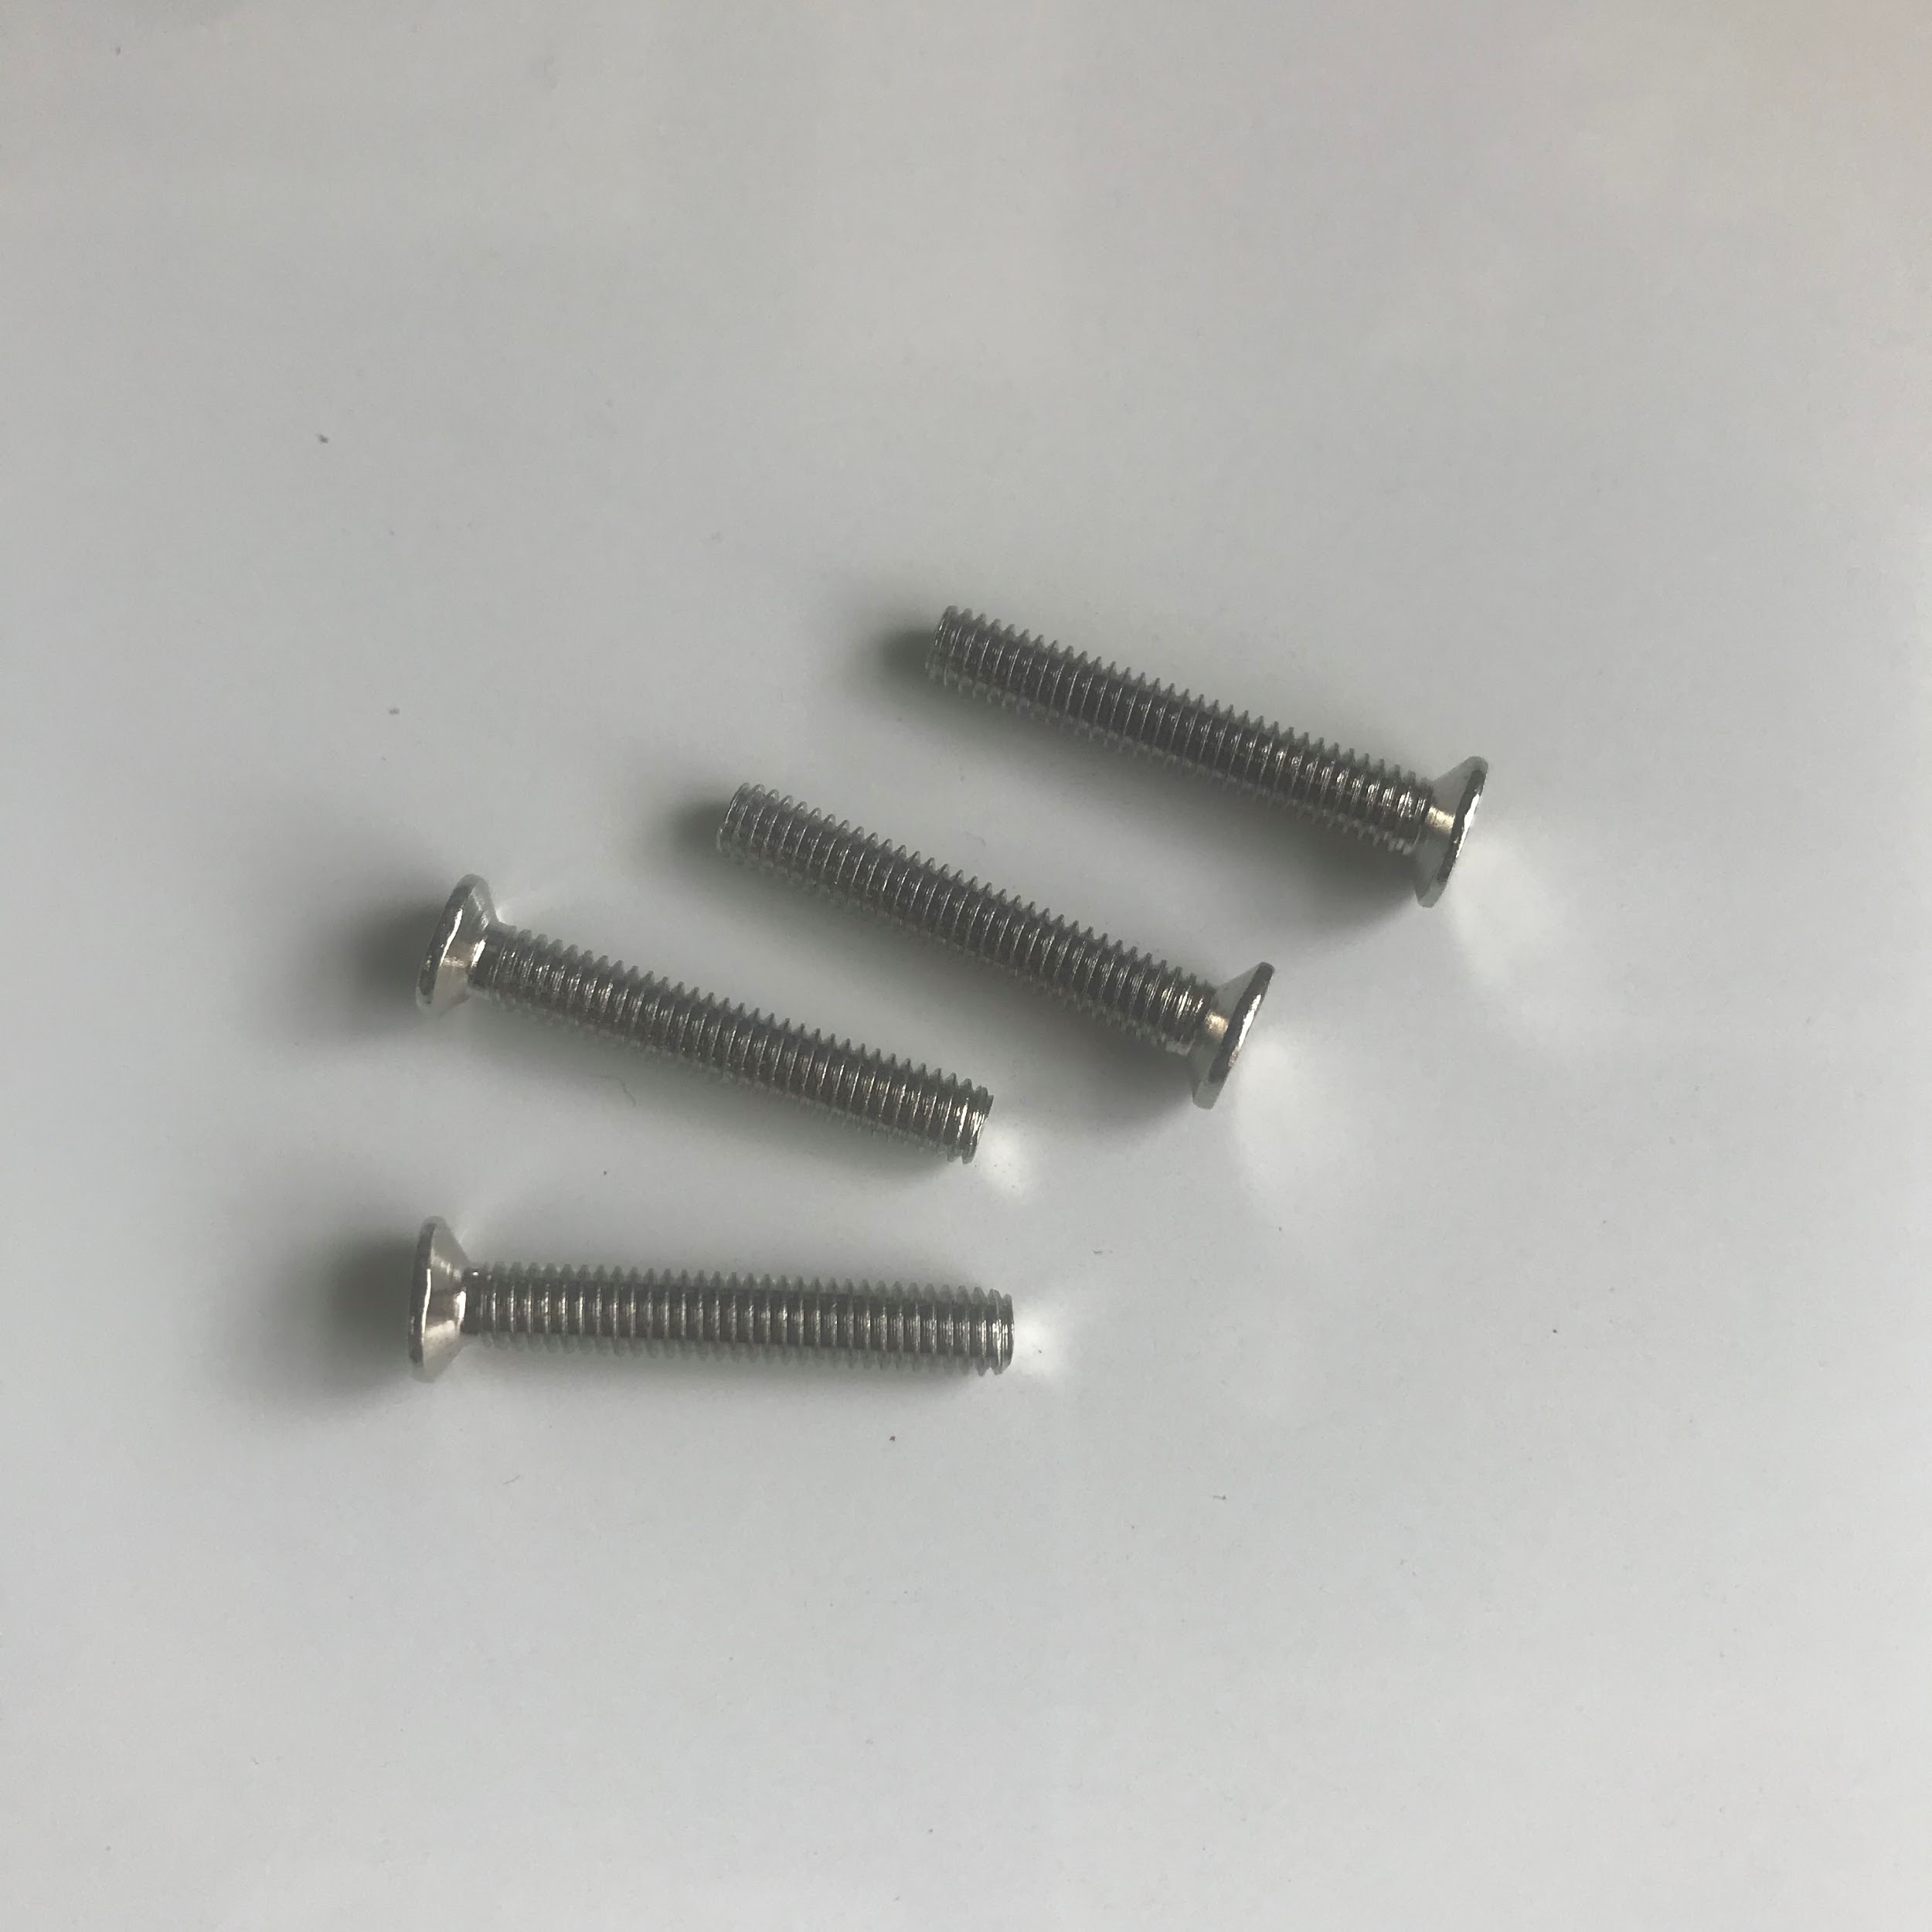
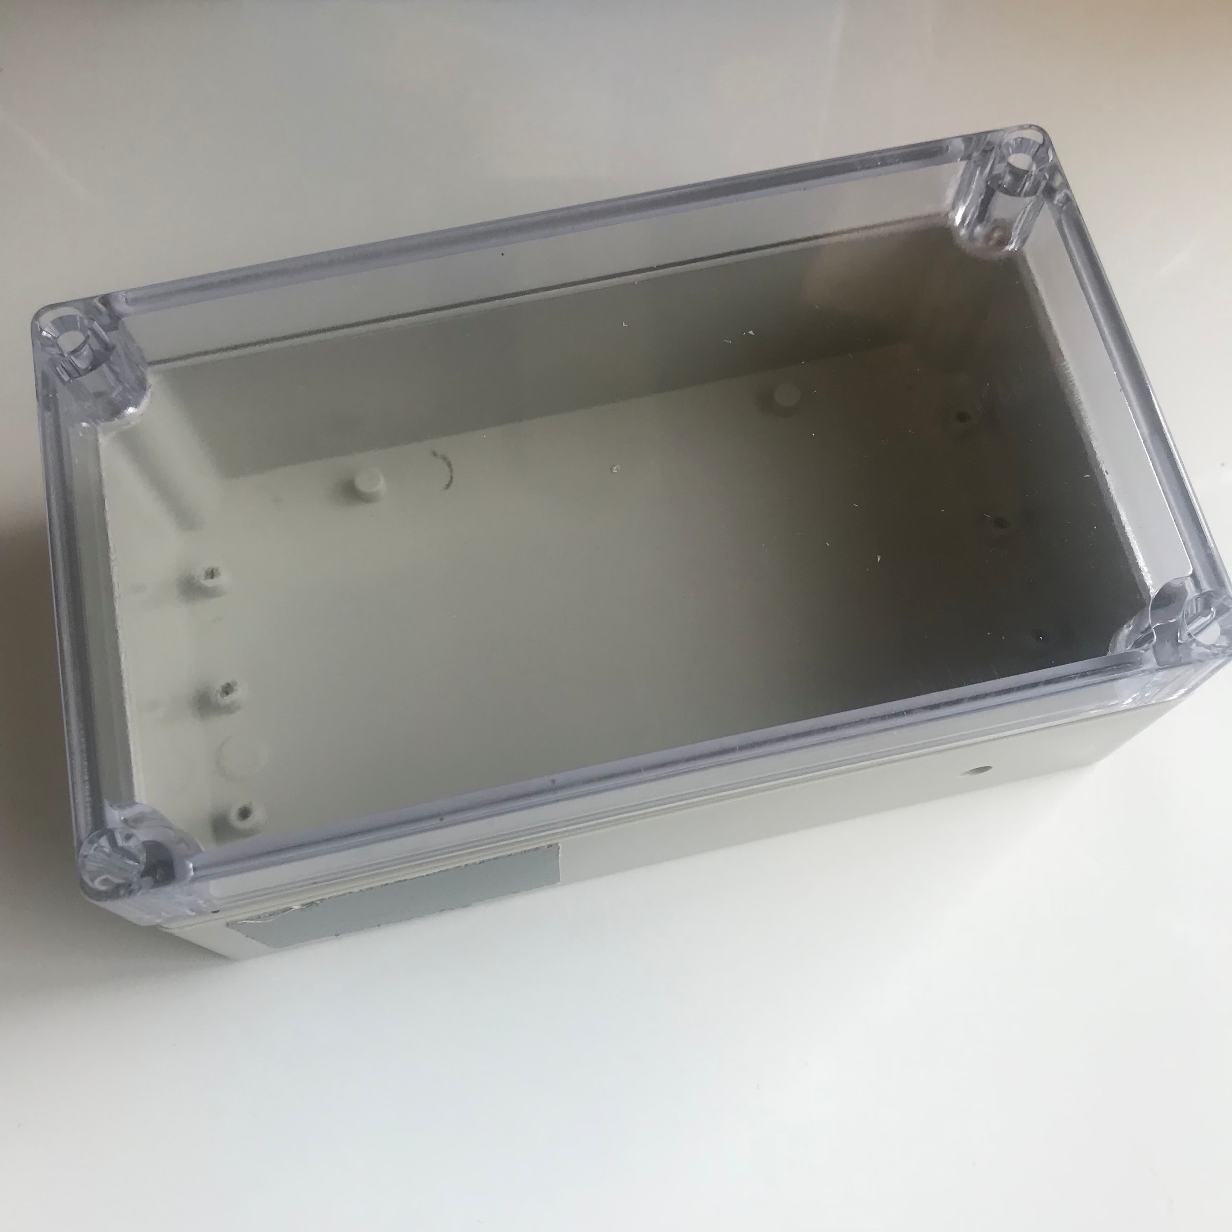

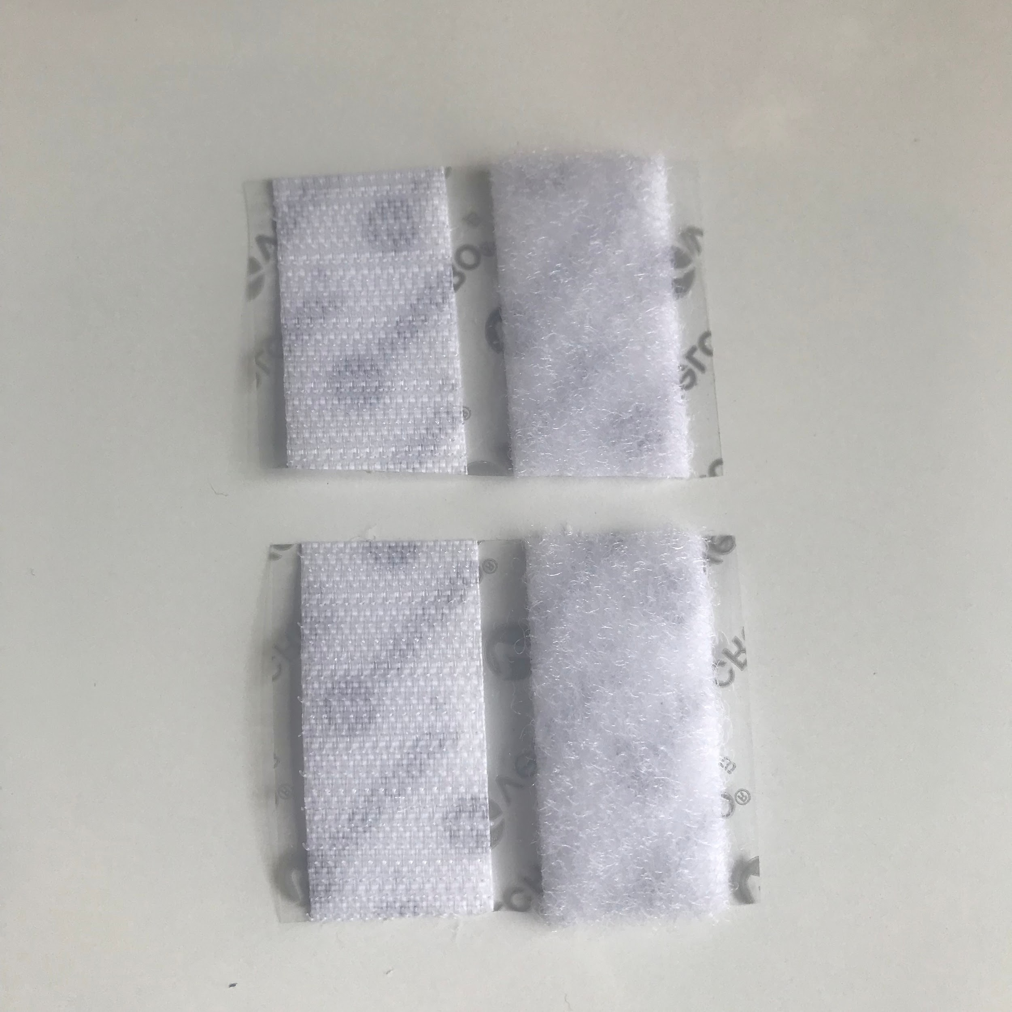
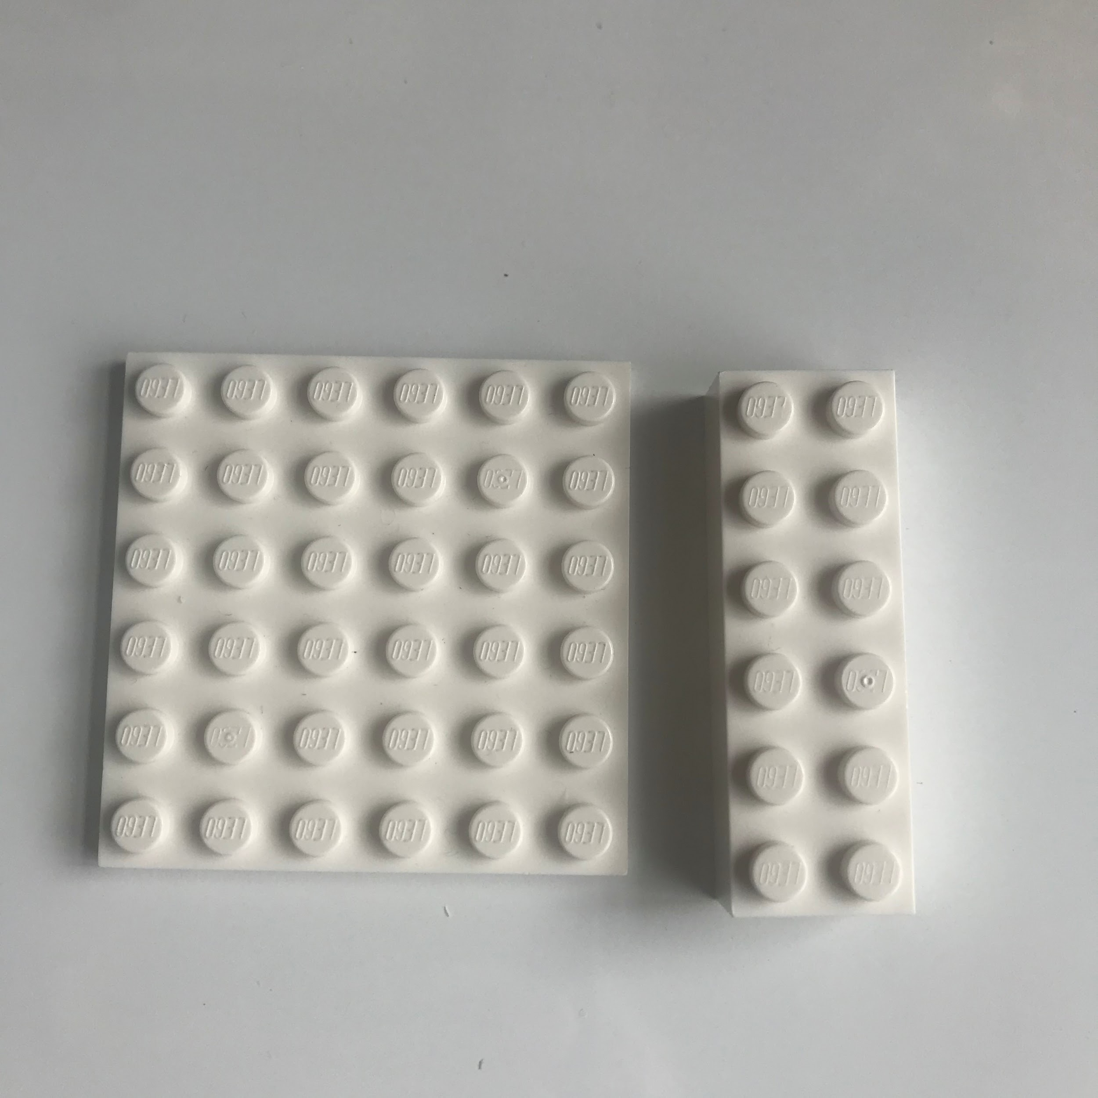
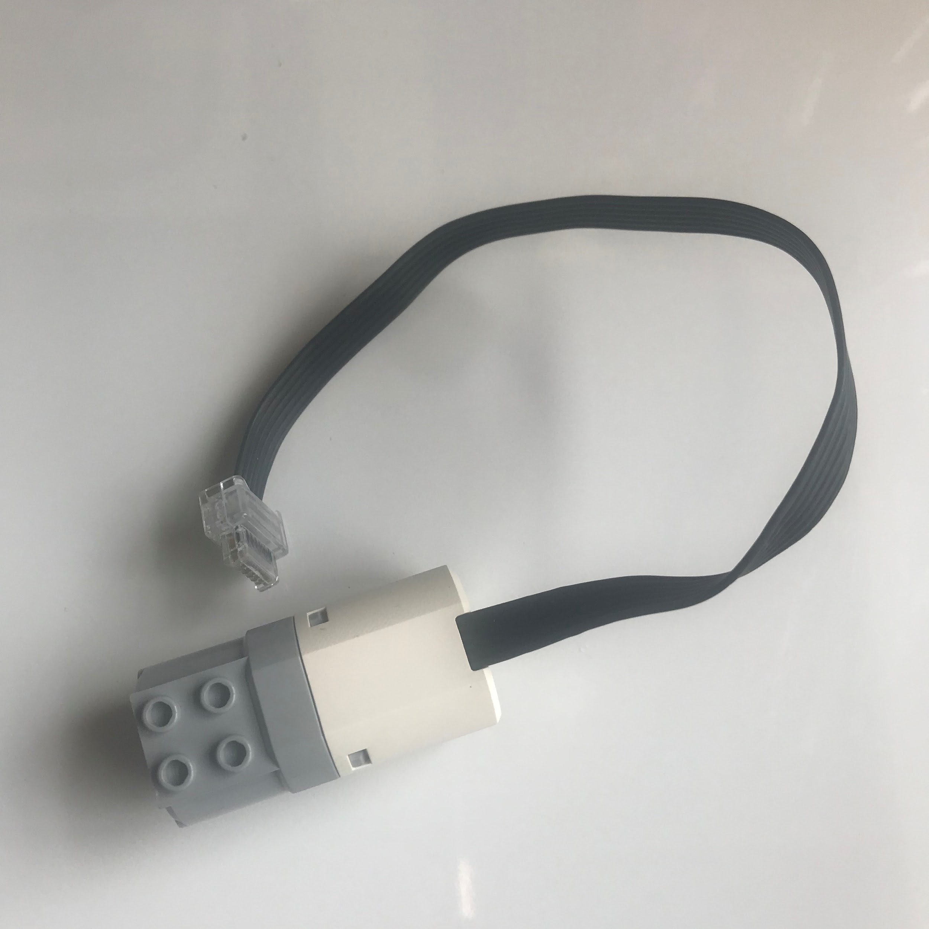
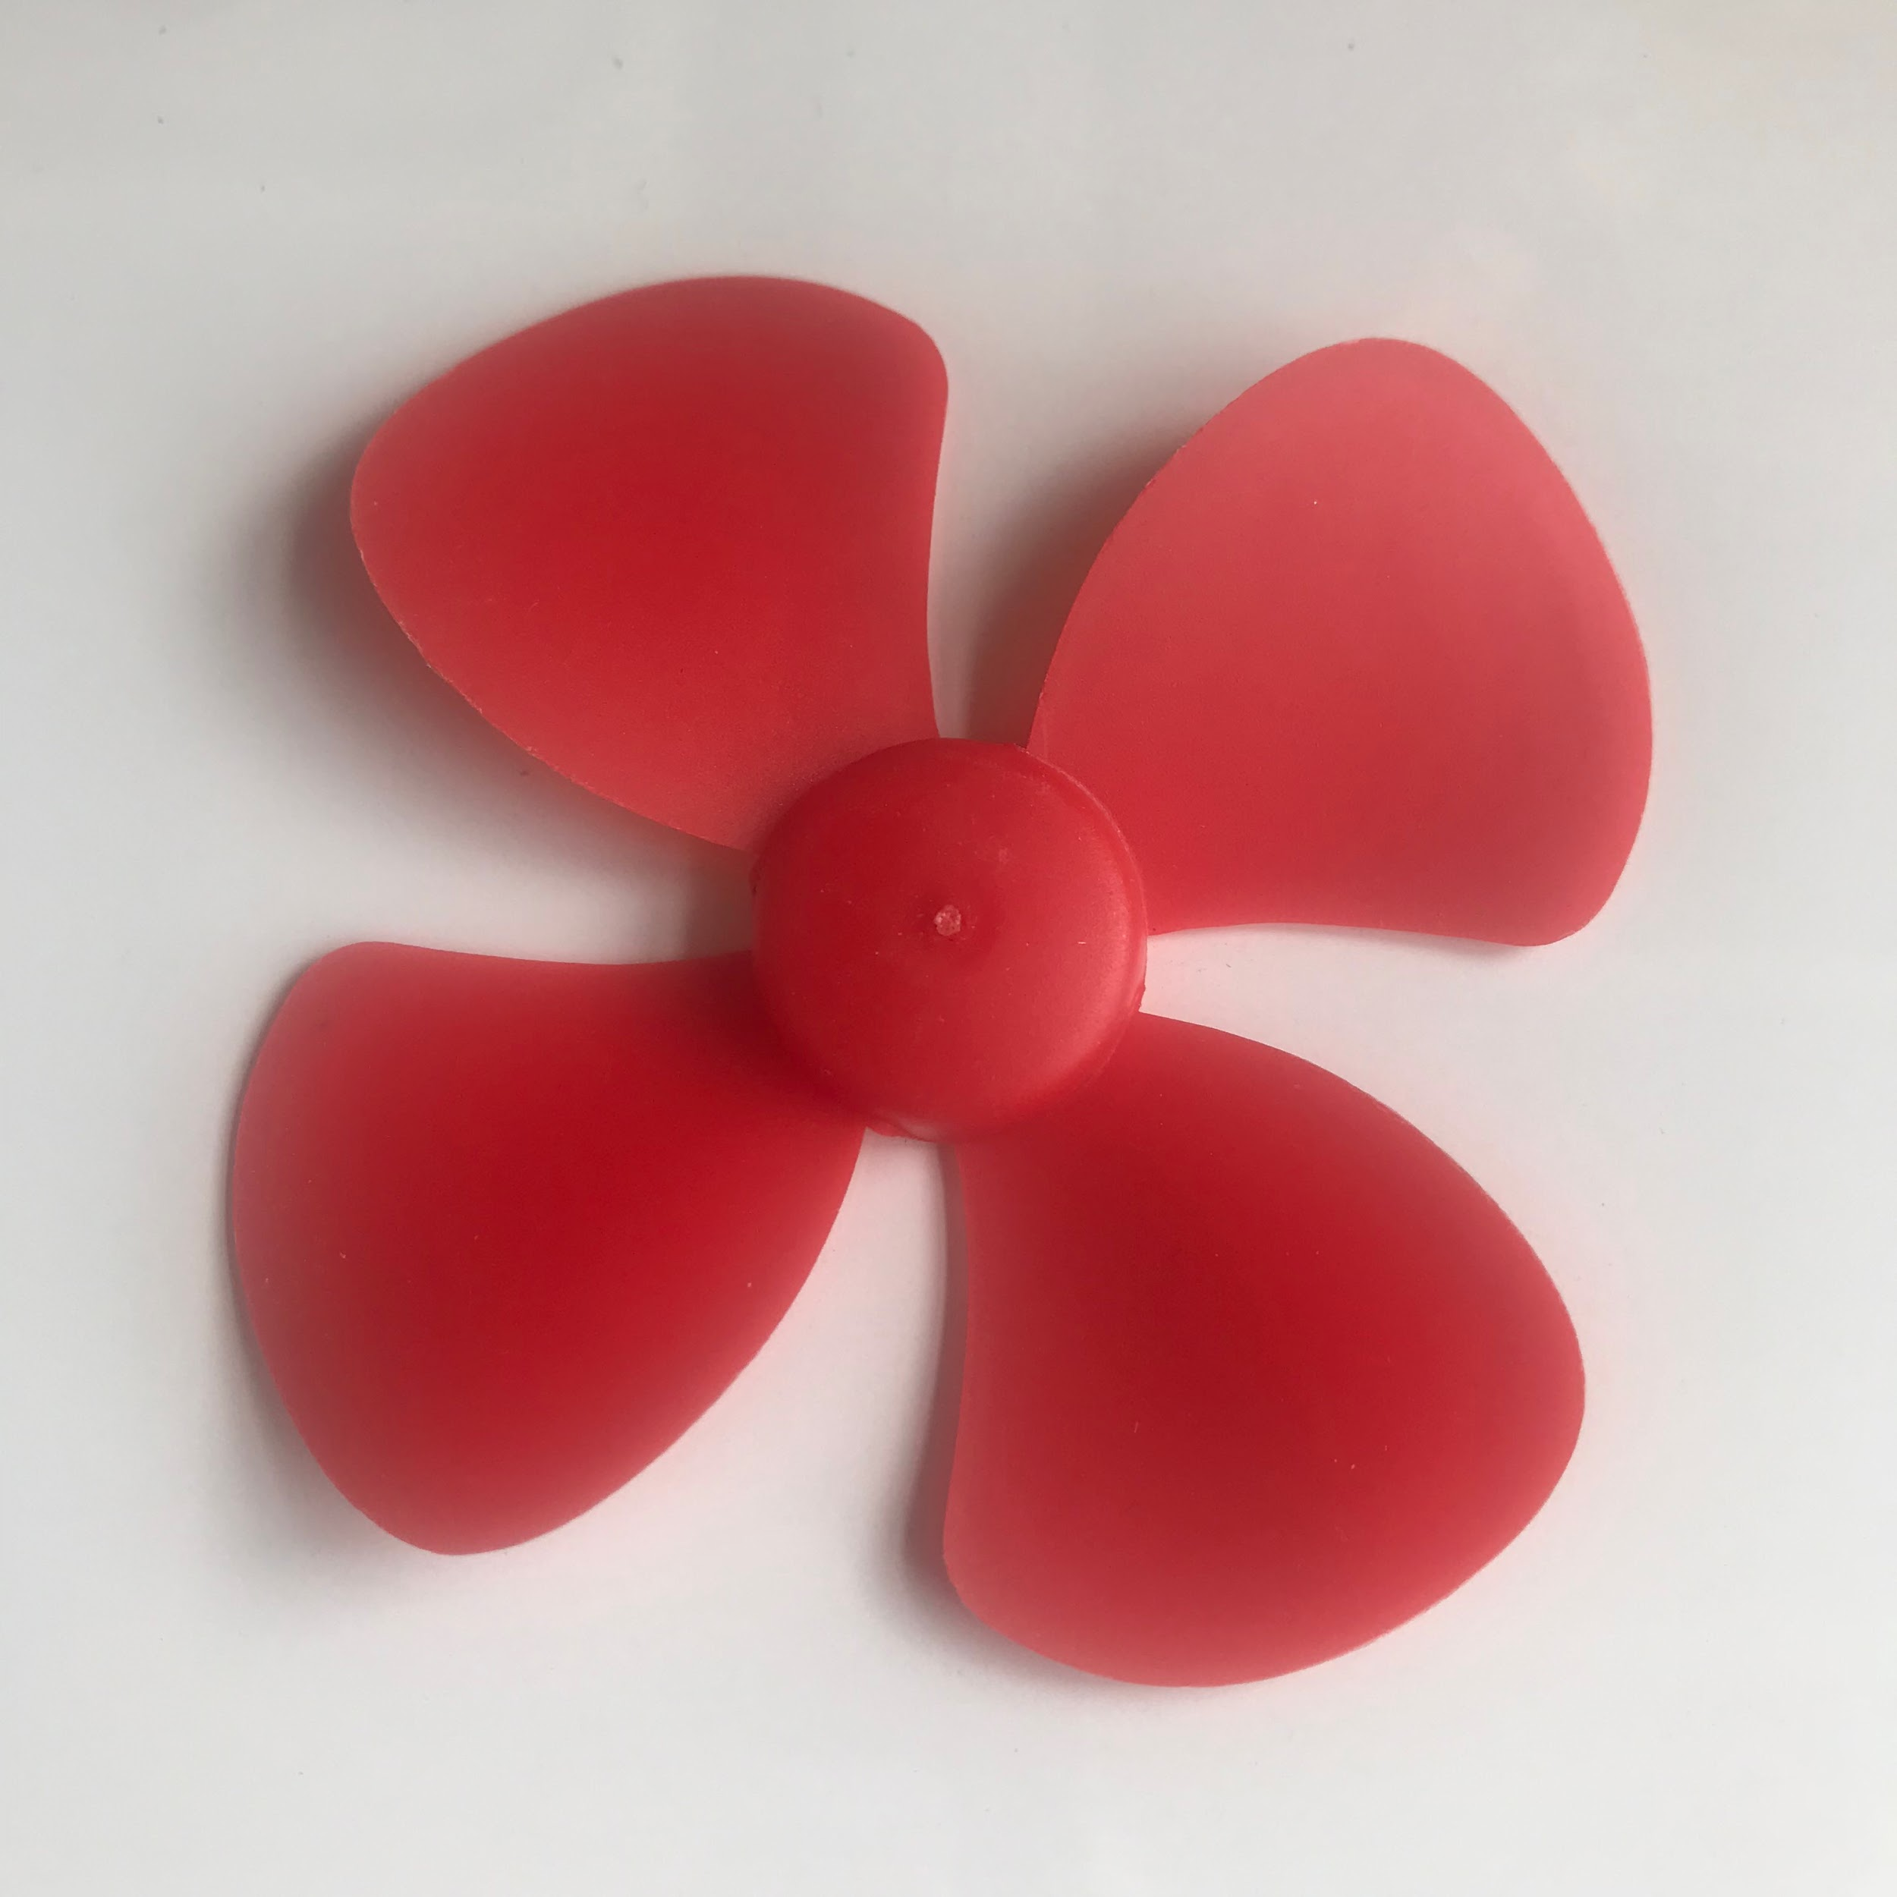
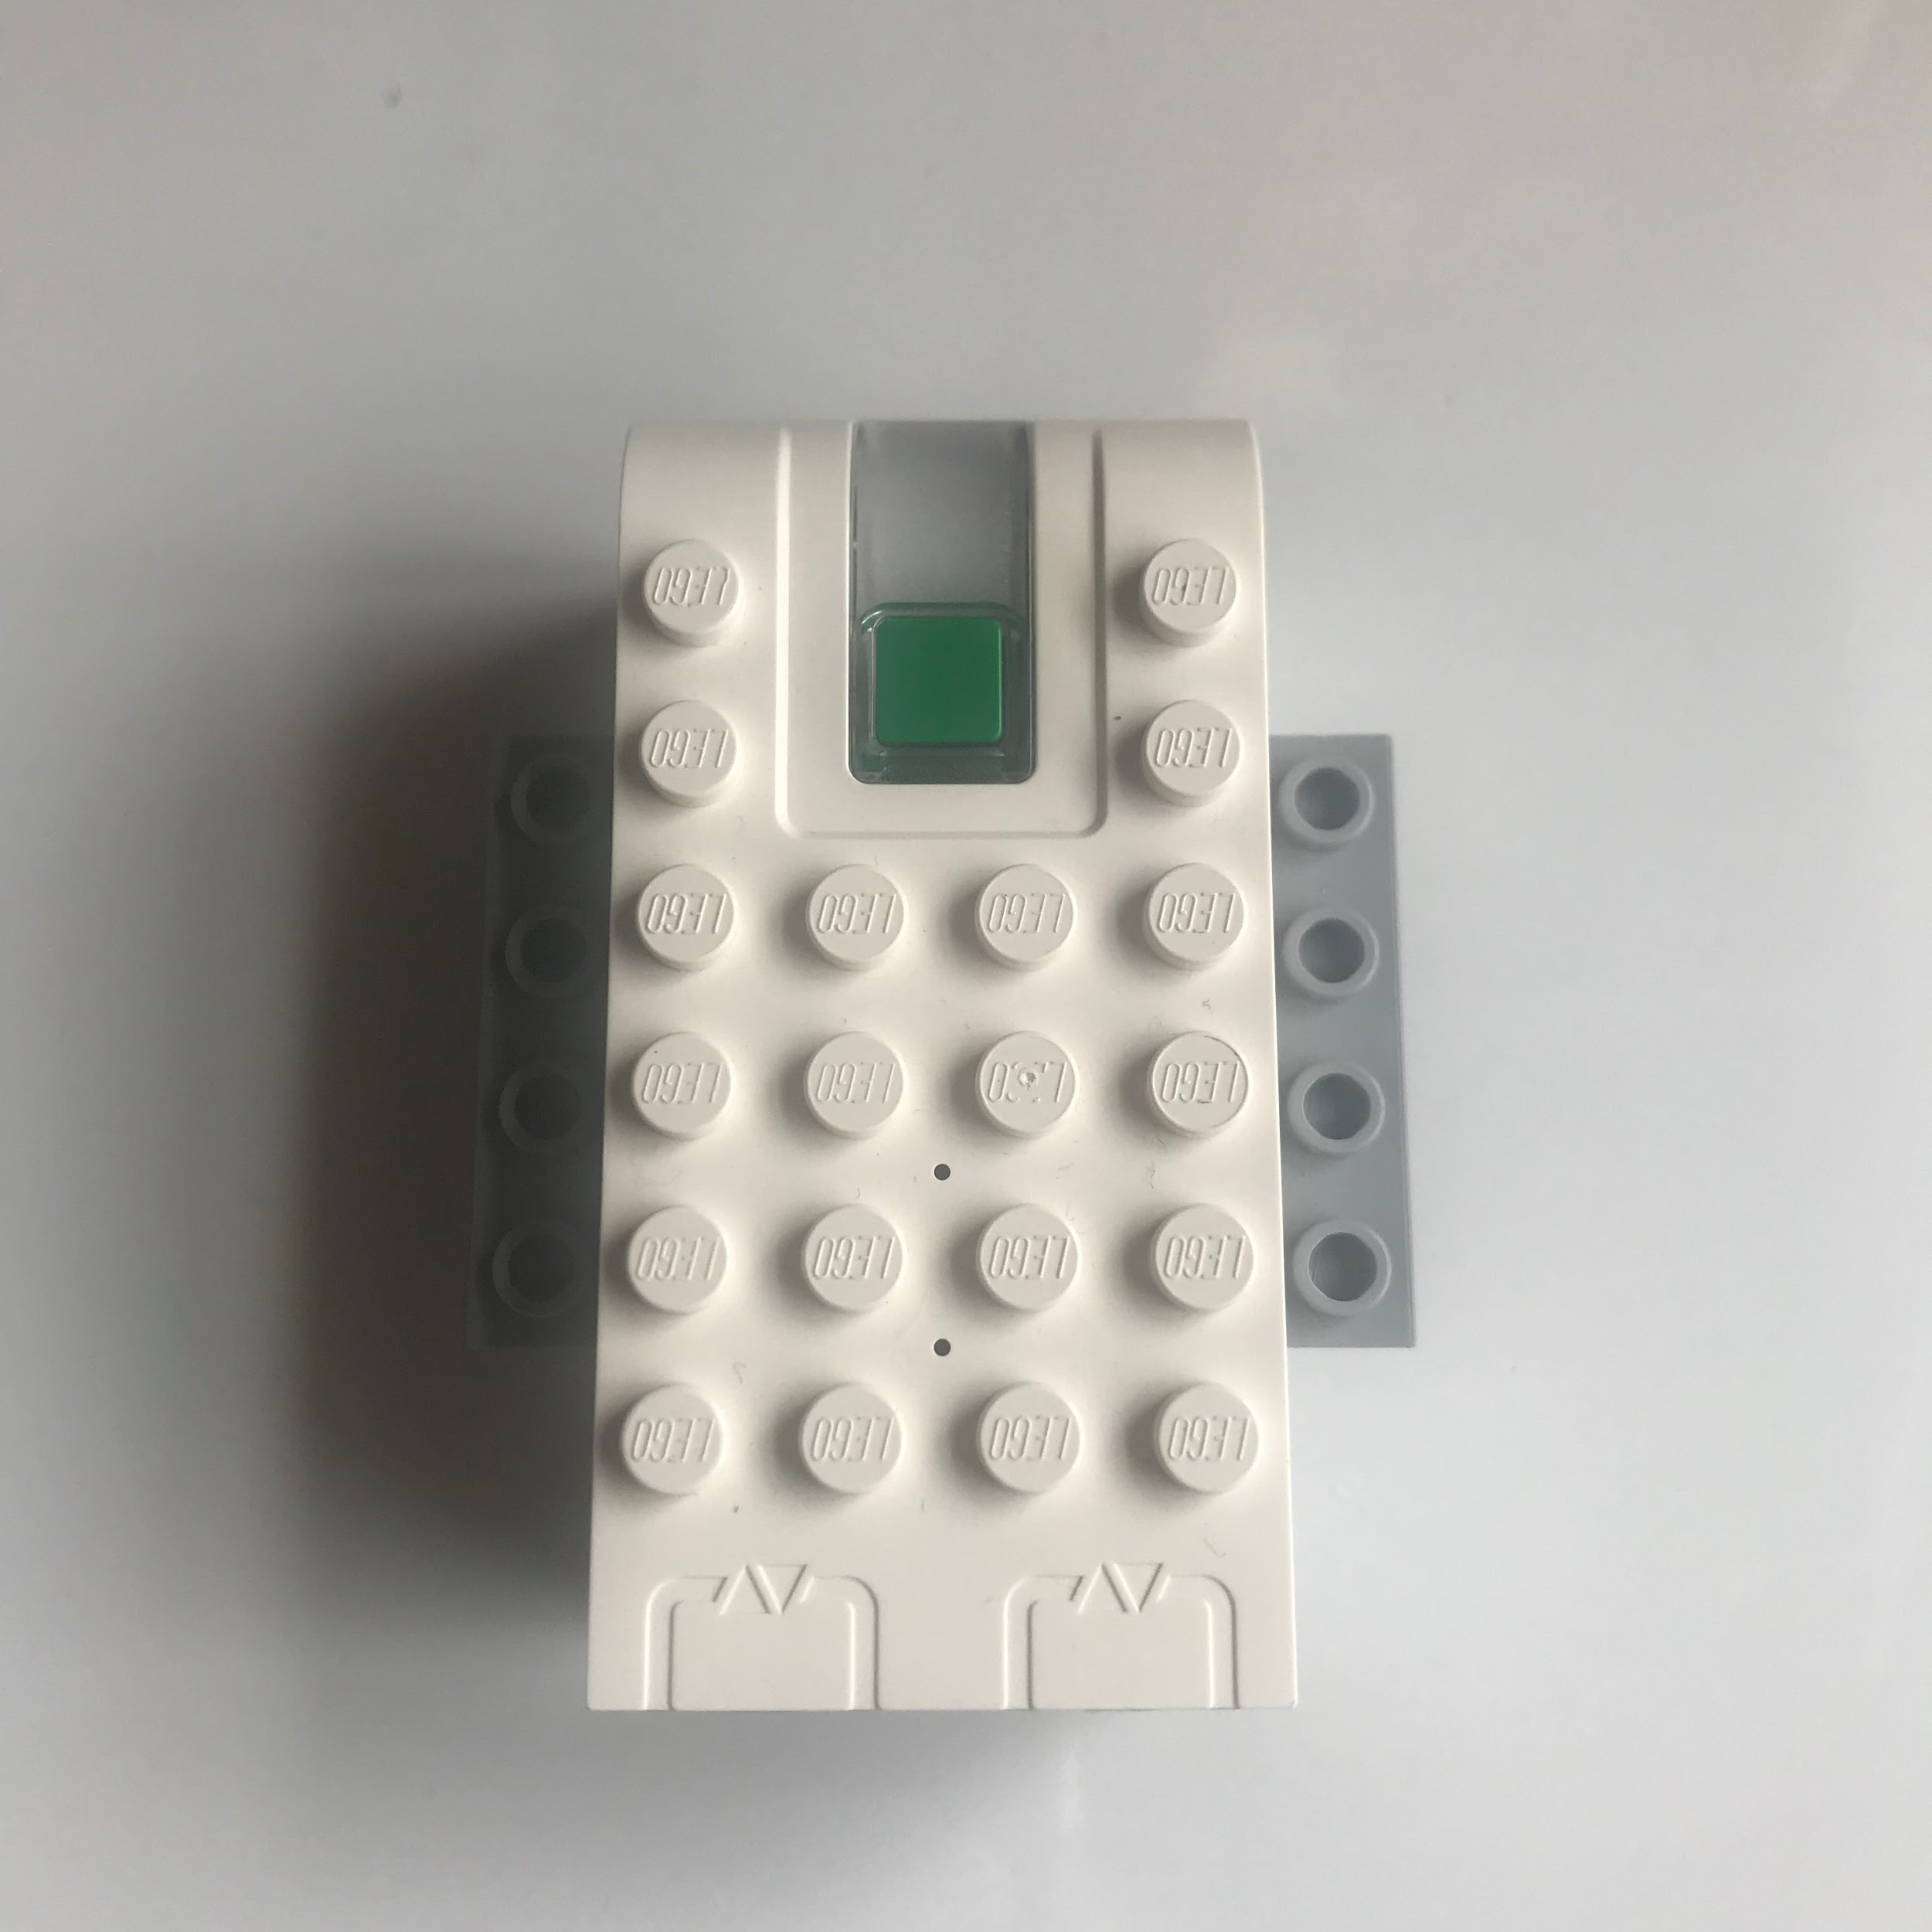
WATERKINESIS KIT CHECKLIST
Flashing LED
Wheel + Stick
4 Screws
Plastic Container
Muse Headset
2 Velcro Pieces
1 Flat Lego and
1 Rectangle
Motor
Propeller
Battery Pack

Slide 5
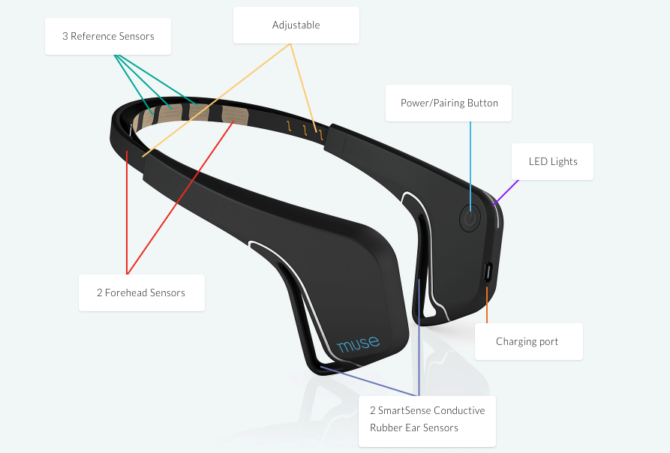
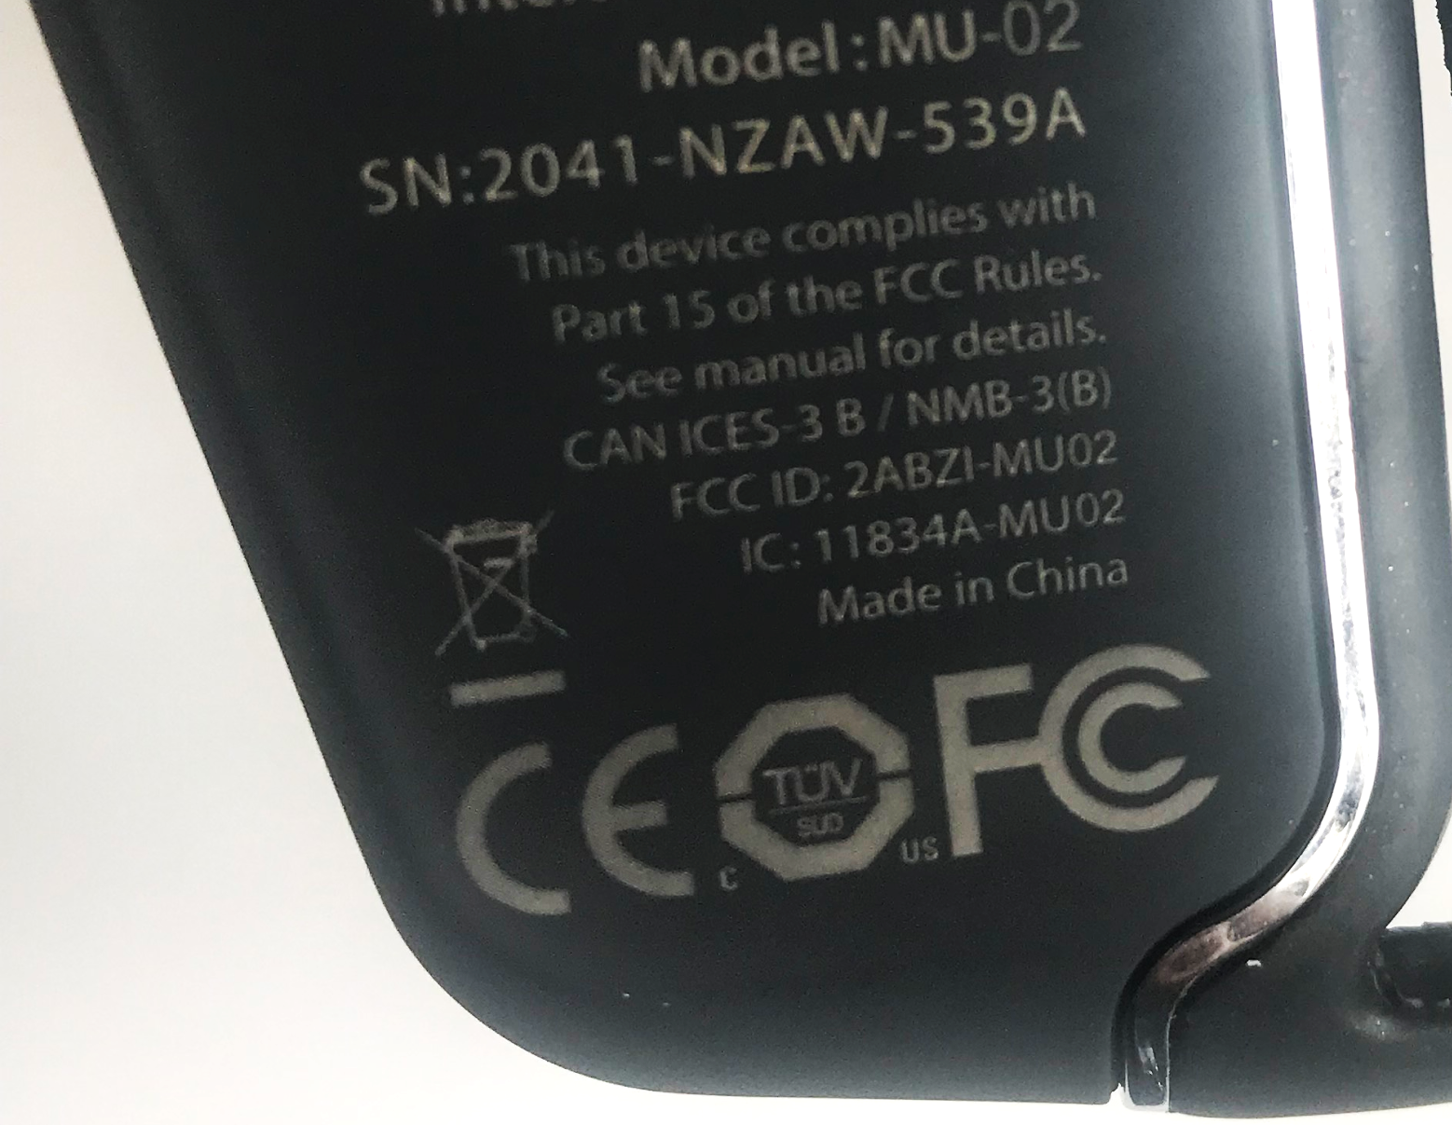
WRITE DOWN YOUR MUSE SERIAL #
Check the inside left of your Muse headset and write down the last 4 digits of the serial number.
For example, your serial number (SN) might be:
2041-NZAW-539A
So, you would write down:
539A

Slide 6
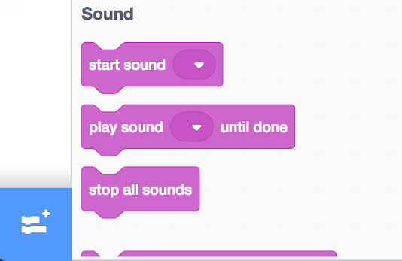
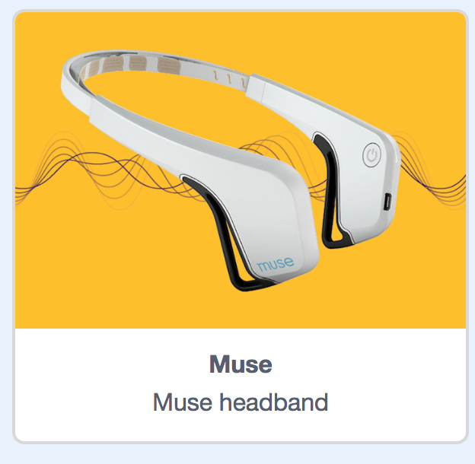
HOW TO CONNECT YOUR ROBOT
Restart your computer (uncheck option to reopen applications at startup)
Turn off Bluetooth, then turn it back on
Go to: https://codelab.cognimates.me and click on extensions button
4. Choose the “Muse” Extension

Slide 7
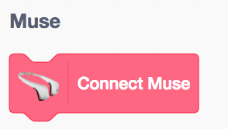
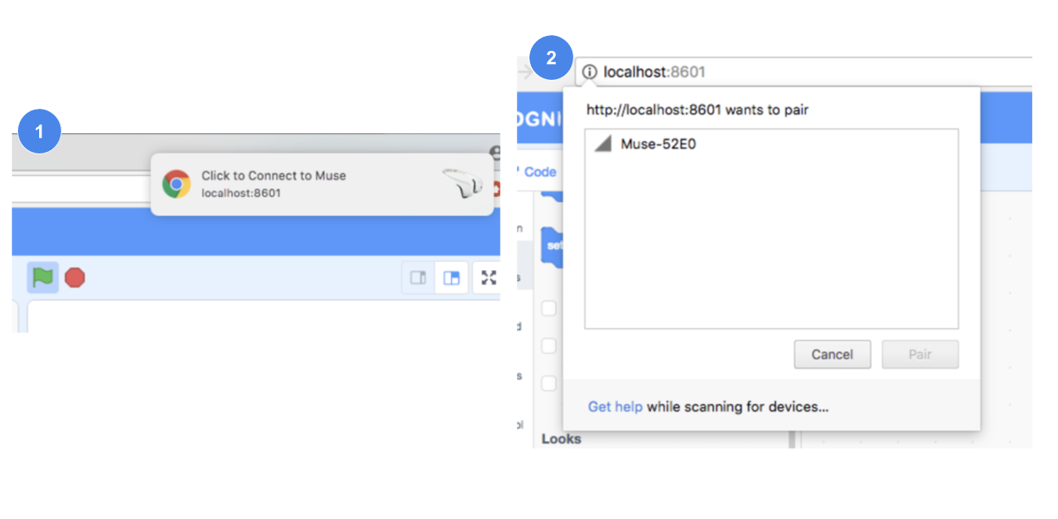

5. Press power button on Muse headset once. Make sure the light begins to flash.
6. Click “Connect Muse” under Muse block
7. Click on the notification that appears in your Chrome browser
8. Select your Muse headset using the last 4 digits of the serial number
9. Click “Pair” to connect to the headset, and check that the light on the Muse stops flashing and the light is on.
10. Put on the Muse, then click on “Get value of <left sensor>” to check that your Muse is measuring numerical values

Slide 8
PUTTING TOGETHER YOUR WEDO
DO NOT TURN ON YOUR LEGO WEDO UNTIL A TEACHER IS PRESENT.
Once your Muse connection is working properly, work as a team to assemble your Lego WeDo
We will come around to help connect and activate your WeDo
Once your WeDo is connected, go to: tinyurl.com/waterkinesis-demo and download the file
In Cognimates, upload the file and begin to code with your team!

Slide 9
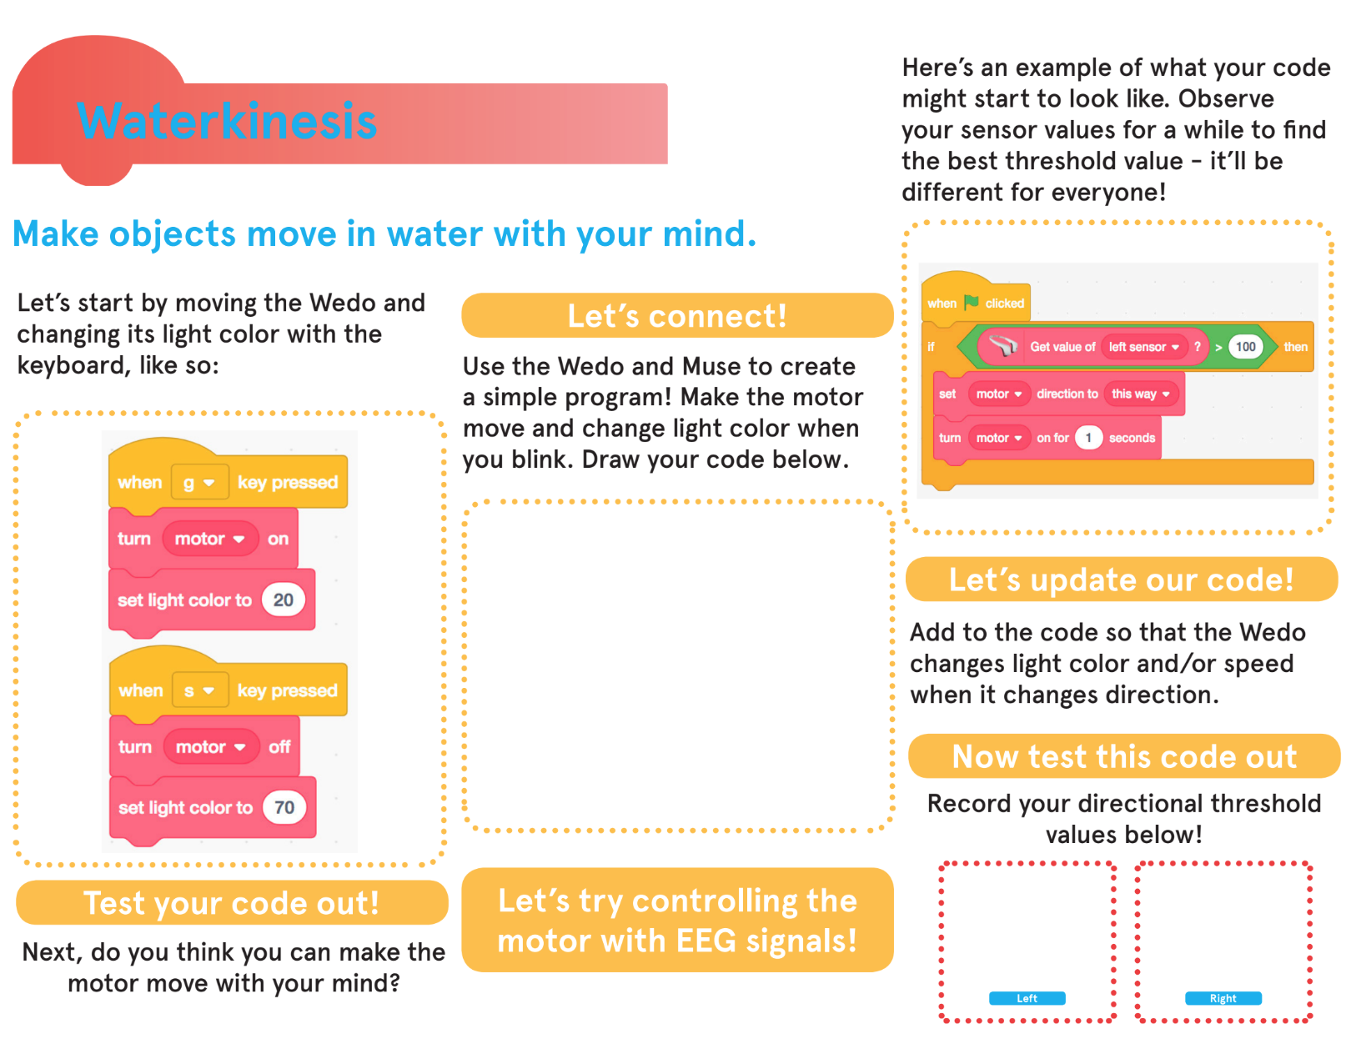

Slide 10
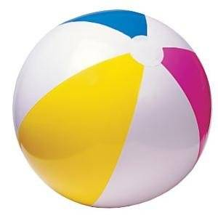
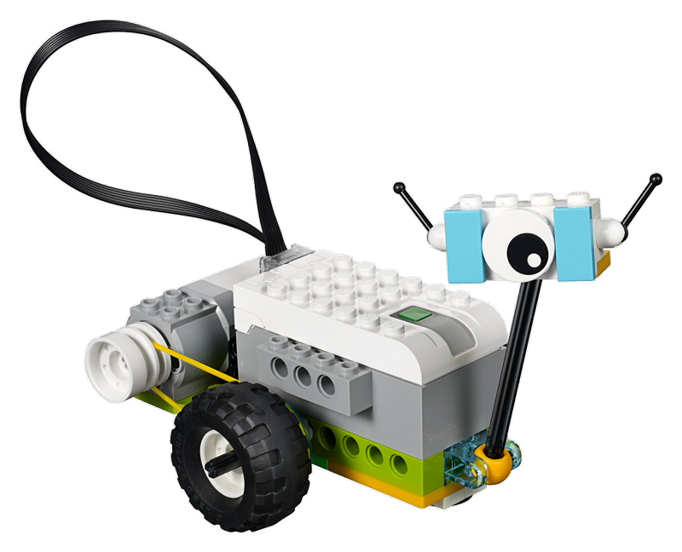
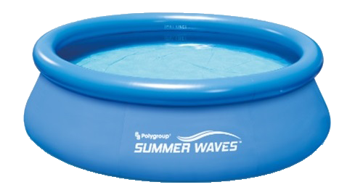
DEMOING YOUR WATERKINESIS ROBOTS
Your team will have 30 seconds to demo your waterkinesis robot for Group 1 and Group 2.
You will place your robot into the pool of water and demo it for 15 seconds.
After 15 seconds, a beach ball will be placed in the pool and you must avoid hitting it.
GOOD LUCK!!!

Slide 11
If You’re Feeling Creative...
Explore the possibilities! You can:
Create a game with your project
Combine your project with another team
Create a competitive game with other teams
Add effects with other Cognimates extensions
Do something completely new!

Slide 12


GROUP REFLECTIONS
What did you learn?
What did you like?
What could have gone better?

Slide 13
Thank you!
We hope you enjoyed the project!

